Slide 1






Kubernetes
Introduction to Storage &
Configuration Management

Slide 2
Agenda
Need for Storage
Storage Concepts
Static Provisioning
Dynamic Provisioning
Storage Objects
Configuration Management
ConfigMap
Secret

Slide 3
Volumes
Persistent Volumes
Persistent Volume Claims
StorageClass
Storage

Slide 4
Storage
Pods by themselves are useful, but many workloads require exchanging data between containers, or persisting some form of data.
For this we have Volumes, PersistentVolumes, PersistentVolumeClaims, and StorageClasses.
Notes:
Storage is one of those things that does tend to confuse people with all the various levels of abstractions
4 ‘types’ of storage
Volumes
Persistent Volumes
Persistent Volume Claims
Storage Classes

Slide 5
Volumes
Storage that is tied to the Pod’s Lifecycle.
A pod can have one or more types of volumes attached to it.
Can be consumed by any of the containers within the pod.
Survive Pod restarts; however their durability beyond that is dependent on the Volume Type.
Notes:
A Volume is defined in the pod Spec and tied to its lifecycle
This means it survives a Pod restart, but what happens to it when the pod is deleted is up to the volume type
volumes themselves can be actually be attached to more than one container within the Pod
very common to share storage between containers within the pod
web server
pre-process data
socket files
logs

Slide 6
Volume Types
awsElasticBlockStore
azureDisk
azureFile
cephfs
configMap
csi
downwardAPI
emptyDir
fc (fibre channel)
flocker
gcePersistentDisk
gitRepo
glusterfs
hostPath
iscsi
local
nfs
persistentVolumeClaim
projected
portworxVolume
quobyte
rbd
scaleIO
secret
storageos
vsphereVolume
Persistent Volume Supported
Notes:
Current list of in-tree volume types supported, with more being added through the “Container Storage Interface”
essentially storage plugin system supported by multiple container orchestration engines (k8s and mesos)
The ones in blue support persisting beyond a pod’s lifecycle, but generally are not mounted directly except through a persistent volume claim
emptyDir is common for scratch space between pods
configMap, secret, downward API, and projected are all used for injecting information stored within Kubernetes directly into the Pod

Slide 7
Volumes
volumes: A list of volume objects to be attached to the Pod. Every object within the list must have it’s own unique name.
volumeMounts: A container specific list referencing the Pod volumes by name, along with their desired mountPath.
apiVersion: v1
kind: Pod
metadata:
name: volume-example
spec:
containers:
- name: nginx
image: nginx:stable-alpine
volumeMounts:
- name: html
mountPath: /usr/share/nginx/html
ReadOnly: true
- name: content
image: alpine:latest
command: ["/bin/sh", "-c"]
args:
- while true; do
date >> /html/index.html;
sleep 5;
done
volumeMounts:
- name: html
mountPath: /html
volumes:
- name: html
emptyDir: {}
Notes:
Volumes is a list of every volume type you want to attach to the Pod
Each volume will have its own volume type specific parameters and a name
Using the name is how we reference mounting that storage within a container

Slide 8
Volumes
volumes: A list of volume objects to be attached to the Pod. Every object within the list must have it’s own unique name.
volumeMounts: A container specific list referencing the Pod volumes by name, along with their desired mountPath.
apiVersion: v1
kind: Pod
metadata:
name: volume-example
spec:
containers:
- name: nginx
image: nginx:stable-alpine
volumeMounts:
- name: html
mountPath: /usr/share/nginx/html
ReadOnly: true
- name: content
image: alpine:latest
command: ["/bin/sh", "-c"]
args:
- while true; do
date >> /html/index.html;
sleep 5;
done
volumeMounts:
- name: html
mountPath: /html
volumes:
- name: html
emptyDir: {}
Notes:
volumeMounts is an attribute within each container in your Pod
they reference the volume name and supply the mountPath
It may have other available options depending on the volume type
e.g. mount read only

Slide 9
Persistent Volumes
A PersistentVolume (PV) represents a storage resource.
PVs are a cluster wide resource linked to a backing storage provider: NFS, GCEPersistentDisk, RBD etc.
Generally provisioned by an administrator.
Their lifecycle is handled independently from a pod
CANNOT be attached to a Pod directly. Relies on a PersistentVolumeClaim
Notes:
PVs are k8s objects that represent underlying storage.
They don’t belong to any namespace, they are a global resource.
As such users aren’t usually the ones creating PVs, that’s left up to admins.
The way a user consumes a PV is by creating a PVC.

Slide 10
PersistentVolumeClaims
A PersistentVolumeClaim (PVC) is a namespaced request for storage.
Satisfies a set of requirements instead of mapping to a storage resource directly.
Ensures that an application’s ‘claim’ for storage is portable across numerous backends or providers.
Notes:
Unlike a PV, a PVC is based within a namespace (with the pod)
It is a one-to-one mapping of a user claim to a global storage offer.
A user can define specific requirements for their PVC so it gets matched with a specific PV.

Slide 11
PersistentVolume
capacity.storage: The total amount of available storage.
volumeMode: The type of volume, this can be either Filesystem or Block.
accessModes: A list of the supported methods of accessing the volume. Options include:
ReadWriteOnce
ReadOnlyMany
ReadWriteMany
apiVersion: v1
kind: PersistentVolume
metadata:
name: nfsserver
spec:
capacity:
storage: 50Gi
volumeMode: Filesystem
accessModes:
- ReadWriteOnce
- ReadWriteMany
persistentVolumeReclaimPolicy: Delete
storageClassName: slow mountOptions:
- hard
- nfsvers=4.1
nfs:
path: /exports
server: 172.22.0.42
Notes:
For a PV, you define the capacity, whether you want a filesystem or a block device, and the access mode.
A word on accessModes:
RWO means only a single pod will be able to (through a PVC) mount this.
ROM means many pods can mount this, but none can write.
RWM means, well, many pods can mount and write.

Slide 12
PersistentVolumeClaim
accessModes: The selected method of accessing the storage. This MUST be a subset of what is defined on the target PV or Storage Class.
ReadWriteOnce
ReadOnlyMany
ReadWriteMany
resources.requests.storage: The desired amount of storage for the claim
storageClassName: The name of the desired Storage Class
kind: PersistentVolumeClaim
apiVersion: v1
metadata:
name: pvc-sc-example
spec:
accessModes:
- ReadWriteOnce
resources:
requests:
storage: 1Gi
storageClassName: slow
Notes:
As with the PV, you define your accessModes for your PVC. A PV and a PVC match through their accessModes.
Likewise, you request how much storage your PVC will require. Finally, you can specify what className you require.
A lot of this can be arbitrary and highly dependent on your environment.

Slide 13
PVs and PVCs with Selectors
kind: PersistentVolume
apiVersion: v1
metadata:
name: pv-selector-example
labels:
type: hostpath
spec:
capacity:
storage: 2Gi
accessModes:
- ReadWriteMany
hostPath:
path: "/mnt/data"
kind: PersistentVolumeClaim
apiVersion: v1
metadata:
name: pvc-selector-example
spec:
accessModes:
- ReadWriteMany
resources:
requests:
storage: 1Gi
selector:
matchLabels:
type: hostpath
Notes:
This example defines a PV with 2Gi of space and a label.
The PV is using the hostPath volume type, and thus they have a label of “type: hostpath”
The PVC is looking for 1Gi of storage and is looking for a PV with a label of “type: hostpath”
Next slide: match on labels

Slide 14
PVs and PVCs with Selectors
kind: PersistentVolume
apiVersion: v1
metadata:
name: pv-selector-example
labels:
type: hostpath
spec:
capacity:
storage: 2Gi
accessModes:
- ReadWriteMany
hostPath:
path: "/mnt/data"
kind: PersistentVolumeClaim
apiVersion: v1
metadata:
name: pvc-selector-example
spec:
accessModes:
- ReadWriteMany
resources:
requests:
storage: 1Gi
selector:
matchLabels:
type: hostpath
Notes:
They will match and bind because the labels match, the access modes match, and the PVC storage capacity is <= PV storage capacity

Slide 15
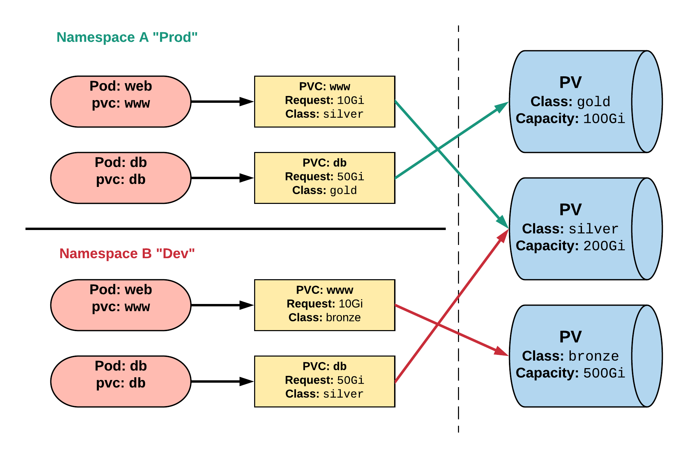
Persistent Volumes and Claims
Cluster Users
Cluster Admins
Notes:
PVCs can be named the same to make things consistent but point to different storage classes
In this example we have a dev and prod namespace.
These PVCs are named the same, but reside within different namespaces and request different classes of storage.

Slide 16
StorageClass
Storage classes are an abstraction on top of an external storage resource (PV)
Work hand-in-hand with the external storage system to enable dynamic provisioning of storage by eliminating the need for the cluster admin to pre-provision a PV
Notes:
PV’s and PVCs work great together, but still require some manual provisioning under the hood.
What if we could do all that dynamically? Well, you can with StorageClasses
Act as an abstraction on top of a external storage resource that has dynamic provisioning capability
usually the cloud providers, but others work like ceph

Slide 17
StorageClass
provisioner: Defines the ‘driver’ to be used for provisioning of the external storage.
parameters: A hash of the various configuration parameters for the provisioner.
reclaimPolicy: The behaviour for the backing storage when the PVC is deleted.
Retain - manual clean-up
Delete - storage asset deleted by provider
kind: StorageClass
apiVersion: storage.k8s.io/v1
metadata:
name: standard
provisioner: kubernetes.io/gce-pd
parameters:
type: pd-standard
zones: us-central1-a, us-central1-b
reclaimPolicy: Delete
Notes:
A storage class is really defined by its provisioner.
Each provisioner will have a slew of different parameters that are tied to the specific storage system it’s talking to.
Lastly is the reclaimPolicy which tells the external storage system what to do when the associate PVC is deleted.

Slide 18
Available StorageClasses
AWSElasticBlockStore
AzureFile
AzureDisk
CephFS
Cinder
FC
Flocker
GCEPersistentDisk
Glusterfs
iSCSI
Quobyte
NFS
RBD
VsphereVolume
PortworxVolume
ScaleIO
StorageOS
Local
Internal Provisioner
Notes:
A list of current StorageClasses
More are supported through CSI plugin

Slide 19
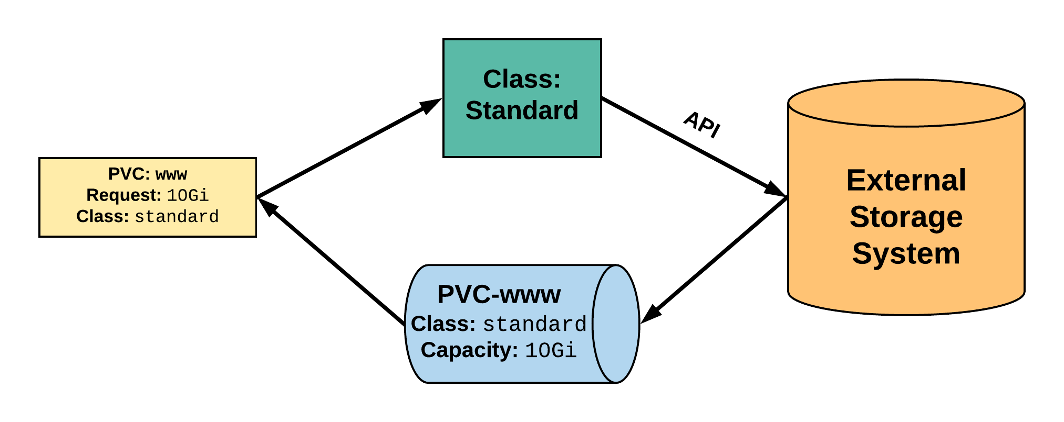
StorageClass
2. StorageClass provisions request through API with external storage system.
1. PVC makes a request of the StorageClass.
uid: 9df65c6e-1a69-11e8-ae10-080027a3682b
4. provisioned PV is bound to requesting PVC.
3. External storage system creates a PV strictly satisfying the PVC request.
pv: pvc-9df65c6e-1a69-11e8-ae10-080027a3682b
Notes:
A PVC is created with a storage request and supplies the StorageClass ‘standard’
The storageClass ‘standard’ is configured with some information to connect and interact with the API of an external storage provider
The external storage provider creates a PV that strictly satisfies the PVC request. Really, it means it’s the same size as the request
The PV will be named pvc-<uid of the pvc>
The PV is then bound to the requesting PVC

Slide 20
ConfigMap
Secret
Configuration

Slide 21
Configuration
Kubernetes has an integrated pattern for decoupling configuration from application or container.
This pattern makes use of two Kubernetes components: ConfigMaps and Secrets.
Notes:
There are instances in your application where you want to be able to store runtime-specific information.
Things like connection info, SSL certs, certain flags that you will inevitably change over time.
The Kubernetes takes that into account and has a solution with ConfigMaps and Secrets.
ConfigMaps and Secrets are kind of like Volumes, as you’ll see.

Slide 22
ConfigMap
Externalized data stored within kubernetes.
Can be referenced through several different means:
environment variable
a command line argument (via env var)
injected as a file into a volume mount
Can be created from a manifest, literals, directories, or files directly.
Notes:
Configmap data is stored “outside” of the cluster (in etcd)
They are insanely versatile. You can inject them as environment variables at runtime, as a command arg, or as a file or folder via a volume mount.
They can also be created in a multitude of ways.

Slide 23
ConfigMap Example
All produce a ConfigMap with the same content!
apiVersion: v1
kind: ConfigMap
metadata:
name: manifest-example
data:
city: Ann Arbor
state: Michigan
$ kubectl create configmap literal-example \
> --from-literal="city=Ann Arbor" --from-literal=state=Michigan
configmap “literal-example” created
$ cat info/city
Ann Arbor
$ cat info/state
Michigan
$ kubectl create configmap dir-example --from-file=cm/
configmap "dir-example" created
$ cat info/city
Ann Arbor
$ cat info/state
Michigan
$ kubectl create configmap file-example --from-file=cm/city --from-file=cm/state
configmap "file-example" created
Notes:
Like I said there are a lot of different ways to create a configmap and all yield the same result.

Slide 24
ConfigMap Example
All produce a ConfigMap with the same content!
apiVersion: v1
kind: ConfigMap
metadata:
name: manifest-example
data:
city: Ann Arbor
state: Michigan
$ kubectl create configmap literal-example \
> --from-literal="city=Ann Arbor" --from-literal=state=Michigan
configmap “literal-example” created
$ cat info/city
Ann Arbor
$ cat info/state
Michigan
$ kubectl create configmap dir-example --from-file=cm/
configmap "dir-example" created
$ cat info/city
Ann Arbor
$ cat info/state
Michigan
$ kubectl create configmap file-example --from-file=cm/city --from-file=cm/state
configmap "file-example" created
Notes:
You can use kubectl and simply pass it strings for everything

Slide 25
ConfigMap Example
All produce a ConfigMap with the same content!
apiVersion: v1
kind: ConfigMap
metadata:
name: manifest-example
data:
city: Ann Arbor
state: Michigan
$ kubectl create configmap literal-example \
> --from-literal="city=Ann Arbor" --from-literal=state=Michigan
configmap “literal-example” created
$ cat info/city
Ann Arbor
$ cat info/state
Michigan
$ kubectl create configmap dir-example --from-file=cm/
configmap "dir-example" created
$ cat info/city
Ann Arbor
$ cat info/state
Michigan
$ kubectl create configmap file-example --from-file=cm/city --from-file=cm/state
configmap "file-example" created
Notes:
You can pass it a folder and it will be smart and map the files to keys within the configmap

Slide 26
ConfigMap Example
All produce a ConfigMap with the same content!
apiVersion: v1
kind: ConfigMap
metadata:
name: manifest-example
data:
city: Ann Arbor
state: Michigan
$ kubectl create configmap literal-example \
> --from-literal="city=Ann Arbor" --from-literal=state=Michigan
configmap “literal-example” created
$ cat info/city
Ann Arbor
$ cat info/state
Michigan
$ kubectl create configmap dir-example --from-file=cm/
configmap "dir-example" created
$ cat info/city
Ann Arbor
$ cat info/state
Michigan
$ kubectl create configmap file-example --from-file=cm/city --from-file=cm/state
configmap "file-example" created
Notes:
Or you can pass the files individually.

Slide 27
Secret
Functionally identical to a ConfigMap.
Stored as base64 encoded content.
Encrypted at rest within etcd (if configured!).
Stored on each worker node in tmpfs directory.
Ideal for username/passwords, certificates or other sensitive information that should not be stored in a container.
Notes:
Secrets for the most part are functionally identical to ConfigMaps with a few small key differences
stored as base64 encoded content
encrypted if configured
great for user/pass or certs
and can be created the same way as configmaps

Slide 28
Secret Example
All produce a Secret with the same content!
apiVersion: v1
kind: Secret
metadata:
name: manifest-example
type: Opaque
data:
username: ZXhhbXBsZQ==
password: bXlwYXNzd29yZA==
$ kubectl create secret generic literal-secret \ > --from-literal=username=example \ > --from-literal=password=mypassword
secret "literal-secret" created
$ cat info/username
example
$ cat info/password
mypassword
$ kubectl create secret generic dir-secret --from-file=secret/
Secret "file-secret" created
$ cat secret/username
example
$ cat secret/password
mypassword
$ kubectl create secret generic file-secret --from-file=secret/username --from-file=secret/password
Secret "file-secret" created
Notes:
Same as ConfigMaps except you now have to tell it what kind of secret (we use generic here)

Slide 29
Secret Example
All produce a Secret with the same content!
apiVersion: v1
kind: Secret
metadata:
name: manifest-example
type: Opaque
data:
username: ZXhhbXBsZQ==
password: bXlwYXNzd29yZA==
$ kubectl create secret generic literal-secret \ > --from-literal=username=example \ > --from-literal=password=mypassword
secret "literal-secret" created
$ cat info/username
example
$ cat info/password
mypassword
$ kubectl create secret generic dir-secret --from-file=secret/
Secret "file-secret" created
$ cat secret/username
example
$ cat secret/password
mypassword
$ kubectl create secret generic file-secret --from-file=secret/username --from-file=secret/password
Secret "file-secret" created
Notes:
From literals

Slide 30
Secret Example
All produce a Secret with the same content!
apiVersion: v1
kind: Secret
metadata:
name: manifest-example
type: Opaque
data:
username: ZXhhbXBsZQ==
password: bXlwYXNzd29yZA==
$ kubectl create secret generic literal-secret \ > --from-literal=username=example \ > --from-literal=password=mypassword
secret "literal-secret" created
$ cat info/username
example
$ cat info/password
mypassword
$ kubectl create secret generic dir-secret --from-file=secret/
Secret "file-secret" created
$ cat secret/username
example
$ cat secret/password
mypassword
$ kubectl create secret generic file-secret --from-file=secret/username --from-file=secret/password
Secret "file-secret" created
Notes:
From a directory

Slide 31
Secret Example
All produce a Secret with the same content!
apiVersion: v1
kind: Secret
metadata:
name: manifest-example
type: Opaque
data:
username: ZXhhbXBsZQ==
password: bXlwYXNzd29yZA==
$ kubectl create secret generic literal-secret \ > --from-literal=username=example \ > --from-literal=password=mypassword
secret "literal-secret" created
$ cat info/username
example
$ cat info/password
mypassword
$ kubectl create secret generic dir-secret --from-file=secret/
Secret "file-secret" created
$ cat secret/username
example
$ cat secret/password
mypassword
$ kubectl create secret generic file-secret --from-file=secret/username --from-file=secret/password
Secret "file-secret" created
Notes:
From individual files

Slide 32
Injecting as Environment Variable
apiVersion: batch/v1
kind: Job
metadata:
name: cm-env-example
spec:
template:
spec:
containers:
- name: mypod
image: alpine:latest
command: [“/bin/sh”, “-c”]
args: [“printenv CITY”]
env:
- name: CITY
valueFrom:
configMapKeyRef:
name: manifest-example
key: city
restartPolicy: Never
apiVersion: batch/v1
kind: Job
metadata:
name: secret-env-example
spec:
template:
spec:
containers:
- name: mypod
image: alpine:latest
command: [“/bin/sh”, “-c”]
args: [“printenv USERNAME”]
env:
- name: USERNAME
valueFrom:
secretKeyRef:
name: manifest-example
key: username
restartPolicy: Never
Notes:
On the left is ConfigMaps, right is Secret
K8s lets you pass all sorts of information into a container, with environment variables being one of them
uses ‘valueFrom’
specify that it comes from a ConfigMap or Secret, give it the cm/secret name and key you want to query

Slide 33
Injecting as a Volume
apiVersion: batch/v1
kind: Job
metadata:
name: cm-vol-example
spec:
template:
spec:
containers:
- name: mypod
image: alpine:latest
command: [“/bin/sh”, “-c”]
args: [“cat /myconfig/city”]
volumeMounts:
- name: config-volume
mountPath: /myconfig
restartPolicy: Never
volumes:
- name: config-volume
configMap:
name: manifest-example
apiVersion: batch/v1
kind: Job
metadata:
name: secret-vol-example
spec:
template:
spec:
containers:
- name: mypod
image: alpine:latest
command: [“/bin/sh”, “-c”]
args: [“cat /mysecret/username”]
volumeMounts:
- name: secret-volume
mountPath: /mysecret
restartPolicy: Never
volumes:
- name: secret-volume
secret:
secretName: manifest-example
Notes:
Last method is actually mounting them as a volume
we specify volume type as a configmap or secret and give it the name

Slide 34

Thank You
youtube.com/KuppiyaSL

